Slide 1

Lecture 13
Iterators & Generators

Slide 2
Announcements

Slide 3

Iterators

Slide 4
Definitions
Lazy evaluation - Delays evaluation of an expression until its value is needed
Iterable - An object capable of returning its members one at a time. Examples include all sequences (lists, strings, tuples) and some non-sequence types (dictionaries).
Iterator - An object that provides sequential access to values, one by one.
All iterators are iterables. Not all iterables are iterators.
Metaphor: Iterables are books & Iterators are bookmarks
Notes:
Demo: Anything you can "for loop" through
show for loop through list &
Can we for loop through a dictionary?

Slide 5
Iterators
two
two
two + three
two
two + three
one
one
one
How do we create iterators?
iter(iterable): Return an iterator over the elements of an iterable value.
This method creates a bookmark from a book starting at the front.
next(iterator): Return the next element in an iterator.
Returns the current page and moves the bookmark to the next page.
The iterator remembers where you left off. If the current page is the end of the book, error.
>>> s = [1, 2, 3] # the book
>>> one, two = iter(s), iter(s)
>>> next(one) # move bookmark 1
1
>>> next(two) # move bookmark 2
1
>>> next(one) # move bookmark 1
2
>>> next(two) # move bookmark 2
2
>>> three = iter(two)
>>>
>>> next(three) # move bookmark 2 & 3
3
>>> next(two) # Ran out of pages
Stop Iteration

Slide 6
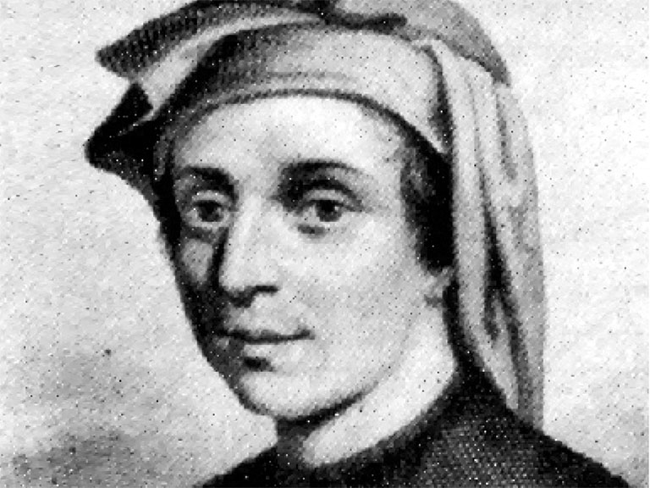
Check Your Understanding: Fibonacci
Define a function that returns an iterator that outputs up to the nth value in the Fibonacci sequence. You can assume n will always be 2 or greater
Remember, iter(iterable) creates an iterator. Lists are iterables.
def fib_iter(n):
"""
>>> x = fib_iter(4)
>>> next(x)
0
>>> next(x)
1
>>> next(x)
1
>>> next(x)
2
"""
Have you missed me?

Slide 7

Exceptions / Errors

Slide 8
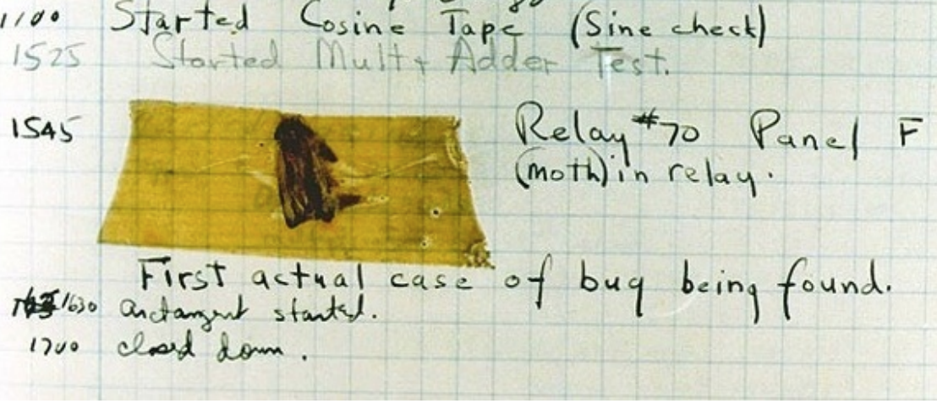
Exceptions / Errors
Sometimes, computer programs behave in non-standard ways
A function receives a argument value of an improper type
Some resources (such as a file) is not available
A network connection is lost in the middle of data transmission
Grace Hopper's Notebook, 1947, Moth found in a Mark II Computer

Slide 9
Raise Exceptions
Exceptions are raised with a raise statement
raise <expression>
<expression> must be an Exception, which is created like so:
E.g., TypeError('Error message')
TypeError -- A function was passed the wrong number/type of argument
NameError -- A name wasn’t found
KeyError -- A key wasn’t found in a dictionary
RuntimeError -- Catch-all for troubles during interpretation

Slide 10
Try Statements
Try statements handle exceptions
try:
<try suite>
except <exception class> as <name>:
<except suite>
Execution rule:
The <try suite> is executed first
If, during the course of executing the <try suite>, an exception is raised that is not handled otherwise then the <except suite> is executed with <name> bound to the exception
>>> try
... x = 1/0
... except ZeroDivisionError as e:
... print('Except a', type(e))
... x = 0
Except a <class ‘ZeroDivisionError’>
>>> x
0

Slide 11
Back to Iterators - The For Statement
for <name> in <expression>:
<suite>
Evaluate the header <expression>, which must evaluate to an iterable object.
For each element in that sequence, in order:
Bind <name> to that element in the first frame of the current environment
Execute the <suite>
When executing a for statement, iter returns an iterator and next provides each item:
>>> counts = [1, 2, 3]
>>> items = iter(counts)
>>> try:
... while True:
... item = next(items)
... print(item)
... except StopIteration:
... pass
1
2
3
>>> counts = [1, 2, 3]
>>> for item in counts: ... print(item)
1
2
3
The same!
These are equivalent!
StopIteration is raised whenever next is called on an empty iterator

Slide 12
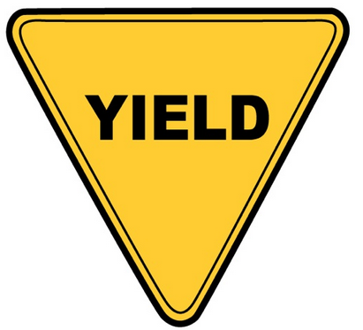
Generators

Slide 13
Definitions and Rules
Some definitions:
Generator: An iterator created automatically by calling a generator function.
Generator function: A function that contains the keyword yield anywhere in the body
When a generator function is called, it returns a generator instead of going into the body of the function. The only way to go into the body of a generator function is by calling next on the returned generator.
Yielding values are the same as returning values except yield remembers where it left off.

Slide 14
Generators and Generator Functions
>>> def plus_minus(x):
... yield x
... yield -x
>>> t = plus_minus(3)
>>> next(t)
3
>>> next(t)
-3
>>> t
<generator object>
>>> next(t) StopIteration
We are allowed to call next on generators because generators are a type of iterator.
Calling next on a generator goes into the function and evaluates to the first yield statement. The next time we call next on that generator, it resumes where it left off (just like calling next on any iterator!)
Once the generator hits a return statement, it raises a StopIteration

Slide 15
Generators to Represent Infinite Sequences
Iterators are used to represent infinite sequences. In this course, when we ask you to write an iterator, we want you to write a generator.
>>> def naturals():
... x = 0
... while True: ... yield x
... x += 1
>>> nats = naturals()
>>> next(nats)
0
>>> next(nats)
1
>>> nats1, nats2 = naturals(), naturals()
>>> [next(nats1) * next(nats2) for _ in range(5)]
[0, 1, 4, 9, 16] # Squares the first 5 natural numbers

Slide 16
Check Your Understanding: Generators
Given the following generator function, what will the call to gen() return?
>>> def gen():
... start = 0
... while start != 10: ... yield start
... start += 1
>>> gen()

Slide 17
Check Your Understanding: Generators
def map_gen(fn, iter1):
"""
>>> i = iter([1, 2, 3, 4])
>>> fn = lambda x: x**2
>>> m = map_gen(fn, i)
>>> next(m)
1
>>> next(m)
4
>>> next(m)
9
>>> next(m)
16
>>> next(m)
Traceback (most recent call last):
...
StopIteration
"""
"*** YOUR CODE HERE ***"

Slide 18
Generators can Yield From Iterators
A yield from statement yields all values from an iterable.
def a_then_b(a, b):
for x in a:
yield x
for x in b:
yield x
def a_then_b(a, b):
yield from a
yield from b
def countdown(k):
if k == 0:
yield 'Blast off'
else:
yield k
yield from countdown(k-1)

Slide 19
Summary
We finally made it! What did we even talk about…
Iterators (bookmarks) are used to iterate over iterables (books).
We use the iter method to turn iterables into iterators and we use the next method to get the next element.
Exceptions can be raised and handled.
Generators are how we implement iterators in this course and use yield statements.
We can use yield from to yield multiple values from an iterable.

